Slide 1
Optimization

Slide 2
Optimization
Optimization refers broadly to a process of making something effective. This usually involves comparing and finding the best solution(s) from a set of solutions normally under some constraints
Key concepts in optimization include:
Objective Function: function which is to optimized (maximized or minimized)
Variables: The parameters or inputs that can be tuned or adjusted to optimize the objective. These are referred to as our decision variables
Constraints: These are conditions, bounds or limits imposed on our decision variables and/or objective function and define feasible regions in which our optimal solution must lie in

Slide 3
Types of Optimization
Linear Optimization (Linear Programming): The objective function and constraints are linear.
Nonlinear Optimization: The objective function or constraints are nonlinear
Integer Optimization: Some or all the decision variables are constrained as integers
Combinatorial Optimization: Optimization over discrete structures that has an exponential number of solutions

Slide 4
Optimization methods
Analytical methods: These methods rely on analytical techniques to solve equations related to the objective function given the constraints to optimal solution
Numerical methods: These iterative techniques when analytical solutions are unattainable. Examples include gradient descent, Newton's method and genetic algorithms.
Heuristic methods: Approximate methods for solving complex optimization problems where finding exact solutions are infeasible. Examples include simulated annealing, genetic algorithms and particle swarm optimization.

Slide 5
Genetic Algorithms
Part of Evolutionary Computation (EC)
Optimization and search problems
Mimics natural selection process of nature
Starts with set of solution (random/heuristic)
Select best performing set of solution from them
Create a next generation of solutions off of them
Find an optimal solution for the problem after a number of successive generations
GA mimics three evolutionary processes: selection, gene crossover, and mutation
Work off of another model (regression, classification etc)

Slide 6
Real World Problems
Scheduling problem:
Rooms and Staff allocation in universities/schools to suit the needs of curriculum.
There are several constraints that must be satisfied eg, one staff member in one room, must be in their area of expertise etc.
Search space is huge.
Traveling Salesman Problem:
Minimization of the total distance traveled by touring all cities exactly once and return to depot city.
very hard combinatorial optimization problem.

Slide 7
Real World Problems
Financial markets rules:
Find the optimal values and combination of all the parameter that affect the market rule trades
It helps decides when to buy/sell shares
We can find near optimal solution from set of combinations through evolutionary algorithms
Data clustering and mining:
Find the optimal central points of clusters
Evolutionary algorithms to find a data centre with an optimal error rate
Mechanical engineering design:
Designing procedures of mechanical components
For instance we are required to improve the ratio of lift to drag for a complex aircraft wing

Slide 8
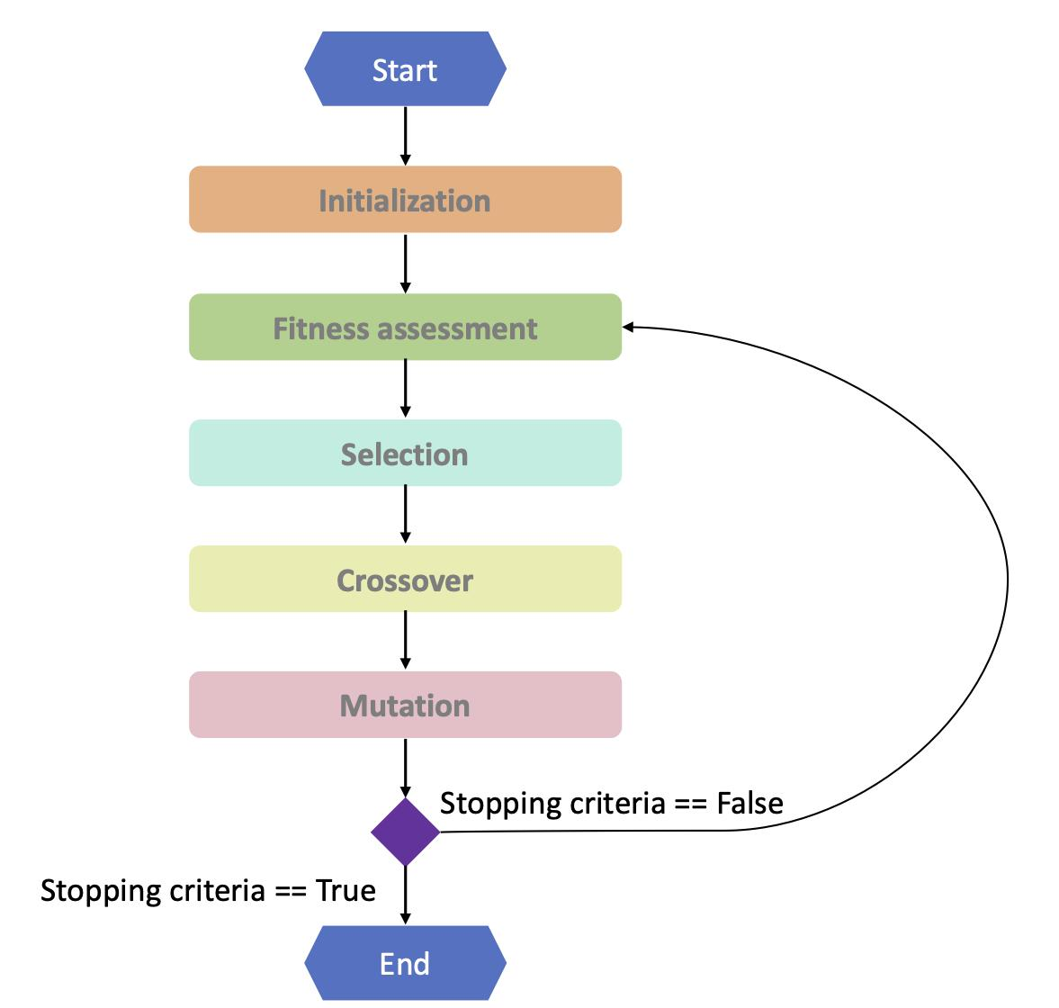
Basic Flow

Slide 9
Basic Terms
Population, collection of possible solutions.
Chromosome, one possible solution
Genotype: elements contained in chromosomes
Phenotype, value of genotype
Fitness Function: measures quality of solution
Fitness Value : return value
Threshold : termination fitness value
Generation : no of iterations

Slide 10
Initialize Population
Determine
No of initial set of solution
The length of chromosomes
Fitness function
Fitness Value threshold
No of generations
Value of the crossover probability (used to generate new population)
Value of mutation probability (used to generate new population)

Slide 11
Selection
Parents are chosen for next generation
Determine the no of pairs
Selection methods
Random Selection
Tournament selection : based on fitness value
Selected pair of parents are also called mating pool

Slide 12
Cross Over
Make child chromosomes for new generation
A pair of parents chromosomes is used to create two child chromosomes
Approaches
Generational: New chromosomes are made in the same number as the old chromosomes and the old population is replaced by the new population.
Steady-state: The number of new chromosomes made is not the same as the old chromosome, but only one or two. The new chromosome will replace the old chromosome.
The probability is used to determine whether a crossover occurs or not

Slide 13
Cross Over

Slide 14
Types of Cross Over
One point crossover: One intersection point
Multi-point crossover: Several intersection points

Slide 15
Types of Cross Over
Uniform crossover: This crossover exchanges genes from one chromosome to another through each index based on probability.
Cannot overcome the drawbacks of parents generation

Slide 16
Mutation
The probability is used to determine whether a mutation to occurs or not
It changes the phenotype of genes
Mutations can be done with one point or can also be with many points, can also be swapped points
Single point mutation

Slide 17
Mutation
Multi-point mutation
Swap

Slide 18
Termination
Maximum runtime (generations)
Threshold of performance

Slide 19
An example linear optimization problem
Suppose a company has profit denoted by the linear equation below:
P = 5x + 3y subject to the following constraints:
2x + y <= 100
x+ 2y <=80
x>= 0,x<40
y>=0,y<40
Goal is to find the maximum profit.

Slide 20
Question
What would be our chromosome?
What would be our fitness or objective function?

Slide 21
Problem formulation
Since the goal is single e.g. maximum profit, we call it a single objective optimization problem.
The decision variables we have in control are x and y and they constitute our chromosome e.g. chromosome = [x,y]
The fitness function is already given to us e.g. P = 5x + 3y, We can use it to find the profit. More profitable solutions are fitter.
Small demo with DEAP library

Slide 22
Genetic Optimization for Regression Models
When we train a regression model, we are effectively a learning a very complex mapping of our input to output e.g
Model(Input) -> Output which is just a very complex function
To frame it as an optimization problem, we can designate some (or all) features to be our control variables. In reality, not all features are important so usually pick the most important features as control variables in optimization. These control variables become our chromose.
The objective function can be the model output e.g Model(Input/Chromosome) or it can be a custom function based off the model output

Slide 23
Demo
Demo of multi objective optimization for a regression model in DEAP

Slide 24
Libraries
DEAP
Pymoo
PyGAD

Slide 25
References
https://towardsdatascience.com/an-illustrated-guide-to-genetic-algorithm-ec5615c9ebe
https://www.toptal.com/algorithms/genetic-algorithms
https://towardsdatascience.com/introduction-to-evolutionary-algorithms-a8594b484ac
https://machinelearningmastery.com/differential-evolution-global-optimization-with-python/
https://analyticsindiamag.com/10-real-life-applications-of-genetic-optimization/

